Slide 1
LID
STM32 Mounting
x
Hole for wires
Hole for wires
Sensors
STM32 Mounting
Hole
for wires
LEDs
BASE

Slide 2
LID
x
BASE

Slide 3
Sensors
LEDs

Slide 4
Sensors
LEDs

Slide 5
Sensors
LEDs

Slide 6
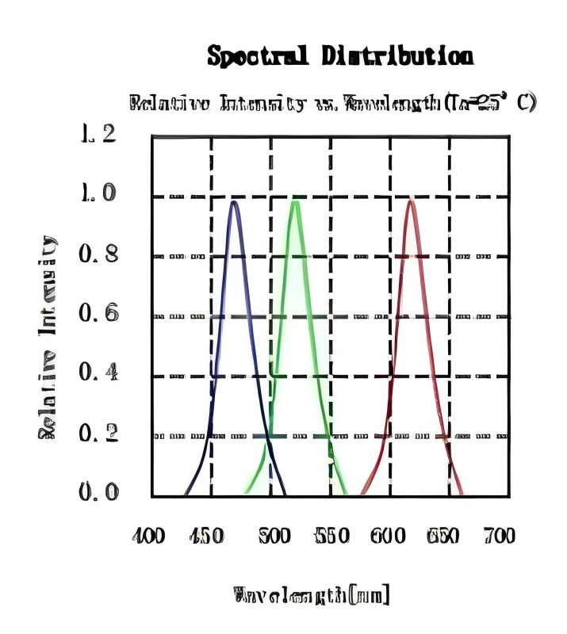
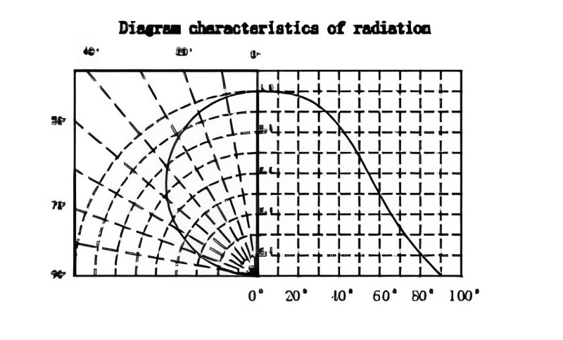
Spectral Distribution
1.2
1.0
0.8
0.6
0.4
0.2
0.0
Relative Intensity vs Wavelength (Ta=25°)
Diagram characteristics of radiation
40°
20°
0°
1.0
50°
0.8
0.6
Relative Intensity
70°
0.4
90°
0.2
0° 20° 40° 60° 80° 100°
400 450 500 550 600 650 700
Wavelength [nm]

Slide 9
LED
sensor
Container for ice/water
30 cm
5 cm
LEDs

Slide 10
9 mm
36 mm

